Slide 1







Best Practices
Application Architecture, Redux
Angular Development
SoftUni Team
Technical Trainers
Software University
http://softuni.bg

Slide 2

Table of Contents
Introduction to Redux
Basic principles of Redux
Moving state to Redux
Using ng-redux to integrate it
The power of immutability

Slide 3
Have a Question?
sli.do #angular-js

Slide 4
Introduction to Redux
Let's start with the famous pattern!

Slide 5
Introduction to Redux
First – isn't Redux a React thing? NO!
Redux:
Predictable state management
Enjoyable developer workflow
Pure functions
First class level support for Angular
Comes with TypeScript bindings
“Redux attempts to make state mutations predictable by imposing certain restrictions on how and when updates can happen”
http://redux.js.org

Slide 6
Introduction to Redux
Redux state
Single source of truth
State is read only
Pure functions drive state changes
Unidirectional data-flow
Warning – do not use it for simple applications! It's overkill!

Slide 7
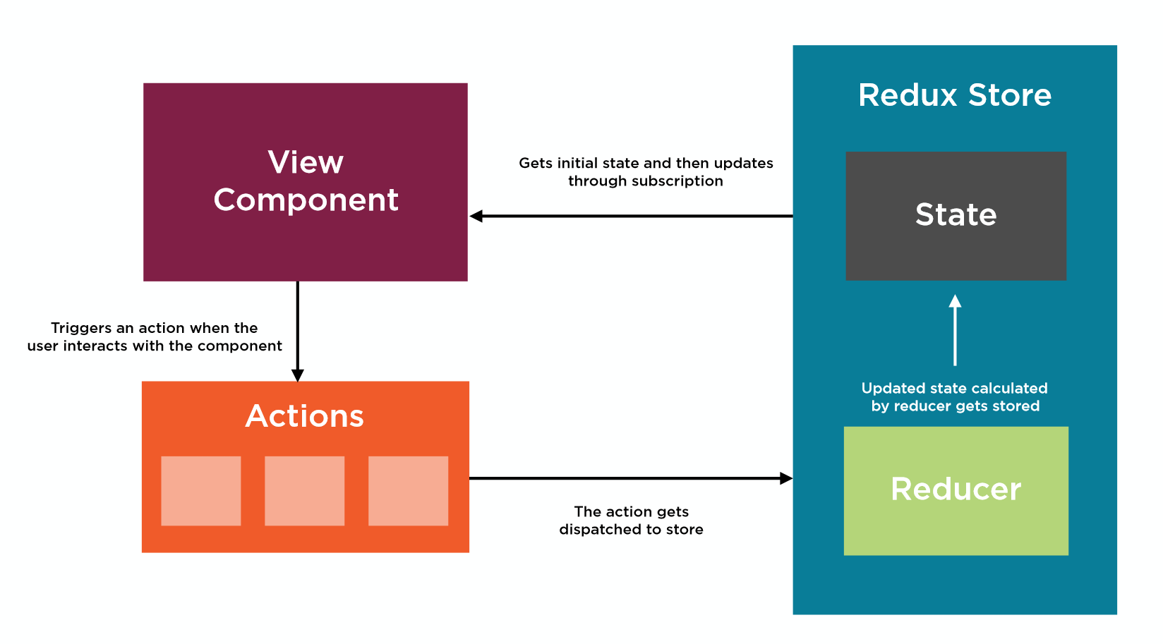
Introduction to Redux

Slide 8
Introduction to Redux
Download the source code
Run the following command
You may install the official Redux Dev Tools
https://chrome.google.com/webstore/detail/redux-devtools/lmhkpmbekcpmknklioeibfkpmmfibljd
npm run start

Slide 9
Introduction to Redux
After you get familiar with the code
Create a folder named store into app
Create the application state - IAppState
import { Course } from '../courses/course';
export interface IAppState {
courses: Course[]
}

Slide 10
Introduction to Redux
Create an initial reducer.ts file into the store folder
import { Course } from '../courses/course';
import { IAppState } from './IAppState';
const initialState: IAppState = {
courses: [
{ id: 1, name: 'Test 1', topic: 'First' },
{ id: 2, name: 'Test 2', topic: 'Second' },
{ id: 3, name: 'Test 3', topic: 'Third' },
]
}
export function reducer(state = initialState, action) {
return state;
}

Slide 11
Introduction to Redux
Create store.ts file into the store folder
Optionally, add index.ts file into the store
import { createStore } from 'redux';
import { reducer } from './reducer';
import { IAppState } from './IAppState';
export const store = createStore<IAppState>(reducer);
export * from './store';
export * from './IAppState';

Slide 12
Introduction to Redux
Go to the course-list.component.ts and start using the store
import { store } from '../store';
updateFromStore() {
const allState = store.getState();
this.courses = allState.courses;
this.filteredCourses = allState.courses;
}
ngOnInit() {
this.updateFromStore();
store.subscribe(() => {
this.updateFromStore();
})
componentHandler.upgradeDom();
}

Slide 13
Introduction to Redux
Let's add the Redux Dev Tools code in store.ts
import {
createStore,
applyMiddleware,
compose,
GenericStoreEnhancer
} from 'redux';
import { reducer } from './reducer';
import { IAppState } from './IAppState';
declare var window: any;
const devToolsExtension: GenericStoreEnhancer = (window.devToolsExtension)
? window.devToolsExtension() : (f) => f;
export const store = createStore<IAppState>(
reducer,
compose(devToolsExtension) as GenericStoreEnhancer);

Slide 14
Introduction to Redux
Now let's handle user input for the filtering
Create actions.ts into the store folder
Export the file from the index.ts
export const FILTER_COURSES = 'courses/FILTER';
export function filterCourses(searchText: string) {
return {
type: FILTER_COURSES,
searchText
};
}

Slide 15
Introduction to Redux
Add filteredCourses to the IAppState and use it in the reducer
function filterCourses(state, action) : IAppState {
return Object.assign({}, state, {
filteredCourses: state.courses.filter(c => {
return c.name.toLowerCase()
.indexOf(action.searchText.toLowerCase()) > -1;
})
})
}
export function reducer(state = initialState, action) {
switch (action.type) {
case FILTER_COURSES:
return filterCourses(state, action);
default:
return state;
}
}

Slide 16
Introduction to Redux
Now use it in the component
filteredCourses = [];
constructor(private _courseService: CourseService) { }
filterChanged(searchText: string) {
console.log('user searched: ', searchText);
store.dispatch(filterCourses(searchText));
}
updateFromStore() {
const allState = store.getState();
this.filteredCourses = allState.filteredCourses;
}

Slide 17
Introduction to Redux
This approach works
However, it does not scale well enough
What about Angular Services?
Let's move to ng2-redux
https://github.com/angular-redux/store

Slide 18
Introduction to Redux
Go to the app.module.ts and prepare it
import { NgReduxModule, NgRedux } from 'ng2-redux';
import { store, IAppState } from './store';
// Add NgReduxModule to the imports array
export class AppModule {
constructor (ngRedux: NgRedux<IAppState>) {
ngRedux.provideStore(store);
}
}

Slide 19
Introduction to Redux
Go to the component and update it (add async to the HTML)
import { store, filterCourses, IAppState } from '../store';
import { NgRedux, select } from 'ng2-redux';
import { Observable } from 'rxjs/Observable';
@select('filteredCourses') filteredCourses$: Observable<Course>;
constructor(private ngRedux: NgRedux<IAppState>) { }
filterChanged(searchText: string) {
console.log('user searched: ', searchText);
store.dispatch(filterCourses(searchText));
}
ngOnInit() {
componentHandler.upgradeDom();
}

Slide 20
Introduction to Redux
Let's dispatch actions – create course.actions.ts
import { NgRedux } from 'ng2-redux';
import { IAppState } from '../store';
import { Injectable } from '@angular/core';
export const FILTER_COURSES = 'courses/FILTER';
@Injectable() // Add it to the providers array
export class CourseActions {
constructor (private ngRedux: NgRedux<IAppState>) { }
filterCourses(searchText: string) {
this.ngRedux.dispatch({
type: FILTER_COURSES,
searchText
});
}
}

Slide 21
Introduction to Redux
And use it in the component
This way we are not using the store directly
constructor(
private ngRedux: NgRedux<IAppState>,
private courseAction: CourseActions) { }
filterChanged(searchText: string) {
console.log('user searched: ', searchText);
this.courseAction.filterCourses(searchText);
}

Slide 22
Introduction to Redux
Finally, let's use external services for the data
Add one more action to the course.actions.ts
getCourses() {
this.courseService.getCourses()
.subscribe(courses => {
this.ngRedux.dispatch({
type: REQUEST_COURSES_SUCCESS,
courses
})
})
}

Slide 23
Introduction to Redux
Update the reducer.ts
function getCourses(state, action): IAppState {
return Object.assign({}, state, {
courses: action.courses,
filteredCourses: action.courses
});
}
export function reducer(state = initialState, action) {
switch (action.type) {
case FILTER_COURSES:
return filterCourses(state, action);
case REQUEST_COURSES_SUCCESS:
return getCourses(state, action);
default:
return state;
}
}

Slide 24
Introduction to Redux
And dispatch the action in the component
Congratulations! You have implemented Redux! ☺
ngOnInit() {
this.courseActions.getCourses();
componentHandler.upgradeDom();
}

Slide 25
Introduction to Redux
What about immutability?
Change the filterCourses function
Not good!
function filterCourses(state, action) : IAppState {
return Object.assign({}, state, {
filteredCourses: state.courses.filter(c => {
c.name = c.name.toLowerCase();
return c.name
.indexOf(action.searchText.toLowerCase()) > -1;
})
})
}

Slide 26
Introduction to Redux
Create freezeState.ts in the store folder
function deepFreeze(obj) {
Object.freeze(obj);
Object.getOwnPropertyNames(obj).forEach(prop => {
if (obj.hasOwnProperty(prop) && obj[prop] !== null
&& (typeof obj[prop] === 'object') && !Object.isFrozen(obj[prop])) {
deepFreeze(obj[prop]);
}
})
return obj;
}
export default function freezeState(store) {
return (next) => (action) => {
const state = store.getState();
deepFreeze(state);
return next(action);
}
}

Slide 27
Introduction to Redux
And apply it to your store
Problem is now fixed! ☺
export const store = createStore<IAppState>(
reducer,
compose(
applyMiddleware(freezeState), devToolsExtension
) as GenericStoreEnhancer);

Slide 28








JavaScript Web – Angular Fundamentals
https://softuni.bg/courses/angular-2-fundamentals

Slide 29

License
This course (slides, examples, demos, videos, homework, etc.) is licensed under the "Creative Commons Attribution-NonCommercial-ShareAlike 4.0 International" license
Attribution: this work may contain portions from
"End-to-end JavaScript Applications" course by Telerik Academy under CC-BY-NC-SA license

Slide 30





Free Trainings @ Software University
Software University Foundation – softuni.org
Software University – High-Quality Education, Profession and Job for Software Developers
softuni.bg
Software University @ Facebook
facebook.com/SoftwareUniversity
Software University @ YouTube
youtube.com/SoftwareUniversity
Software University Forums – forum.softuni.bg

